Slide 1



DANA PARTNERS
MINI PROGRAM INTEGRATION GUIDE
NAME OF PROJECT:
PRESENTED BY:
PRESENTED TO:
Integration Guide
Project Integration Team
Merchant

Slide 2


Agenda
01 | Mini Program Lifecycle
02 | Tech Guideline (Frontend & Backend)
03 | UI Guideline

Slide 3

Mini Program Lifecycle
Onboarding
Apply for an account
Onboarding approval
Install Mini Program IDE
Create a Mini Program
Development
Share UIUX Flow
Create project in IDE
Code
Sandbox Testing
UAT Result
Review & Release
Release Mini Program
Production Operation Test
Sign Off Prod TO Result
Gradual Live Rollout
Agreement Signed

Slide 4




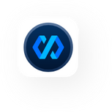
Onboarding Phase
Approval by Biz Ops, TS, CFM, etc)
Business Information
DANA Use Cases (widget, disbursement, etc)
Legal Documents (KTP, Izin usaha, etc)
Register for Merchant Portal:
https://www.dana.id/enterprise/
equal with https://dashboard.dana.id/app/
SANDBOX
Client ID
Merchant ID (MID)
Client Secret
Public & Private Key
Approval by Project Integration
Merchant share
timeline integration plan
Register for Mini Program Console:
https://mini-program.dana.id/index
Business Information
Workspace created;
Can start development
Invite DANA team to workspace through email
This is for partners that onboarding the WebView solution to the mini program container
Download MP IDE:
https://miniprogram.alipay.com/downloads

Slide 5



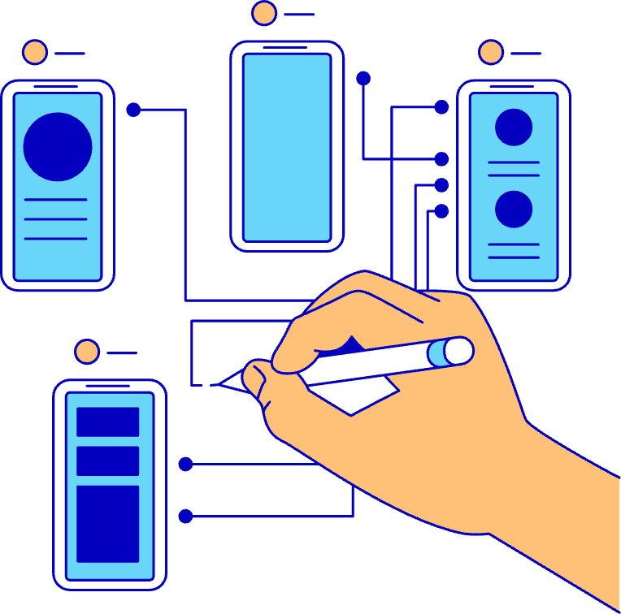

Development Phase
Approval by Project Integration
Merchant Share UI/UX Flow
Merchant DEVELOPMENT
Merchant create
Mini Program in SANDBOX
Merchant UAT in SANDBOX environment
Merchant upload UAT Result & Fill in Production Key Pair on Merchant Portal
DANA review on the UAT result document
OK
Not OK
Bug Fixing
If there is Authentication process, DANA team to setup CDP
(Content Delivery Platform)

Slide 6


Production Phase
Agreement Signed
Approval by Project Integration
PRODUCTION Credential
Client ID
Merchant ID (MID)
Client Secret
Public & Private Key*
Merchant release
Mini Program in PRODUCTION environment
PRODUCTION Test Operational
Test Operational
Sign Off
Gradual Live Rollout
DANA Employee
Public
(10-30-60-100%)
OK
Final Release
will not impact anything, still need gradual release flow to be LIVE in DANA
Not
OK
Bug Fixing
Settlement Recon Checking
(if any)
Merchant Submit Security Checklist
(if any)
Merchant Portal Operational Workshop
(if needed)
If there is Authentication process, DANA team to setup CDP
(Content Delivery Platform)
MANDATORY IF
merchant have payment inside the mini program
MANDATORY IF
merchant using Web View solution inside the mini program container

Slide 7
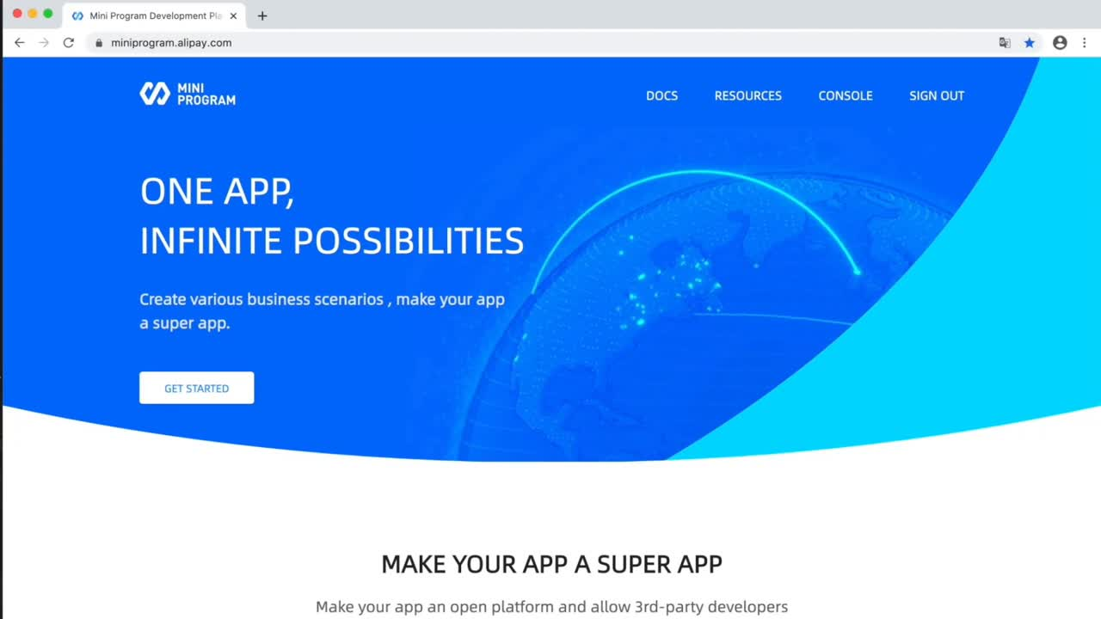
Frontend Integration Guideline
Complete guidelines of the mini program console:
https://mini-program.dana.id/docs/

Slide 8
Why Mini Program DSL Better?
Aspect | Mini Program DSL (native) | WebView (Embedded Website)
Performance | ✅ Faster Load Time - Uses native rendering, optimized for mobile | ❌ Slower – Full web page loads with heavier resources
UI/UX | ✅ Native - like UI and smooth animations | ❌ Less responsive, limited to browser behaviors
Integration with Host App | ✅ Tight integration with DANA - access user info, payments, vouchers, etc. | ❌ Limited – needs bridges or SDK injection to communicate
Offline Capability | ✅ Built-in caching and local storage options | ❌ Relies on web browser cache
Security | ✅ Sandboxed and verified by host platform | ❌ Higher risk if loading third-party web content
User Trust | ✅ Feels like part of the DANA app | ❌ Users may feel redirected or less secure
Dev Efficiency | ✅ Optimized APIs for wallet features, events, QR scan, location, etc. | ❌ Requires custom integration for native features

Slide 9
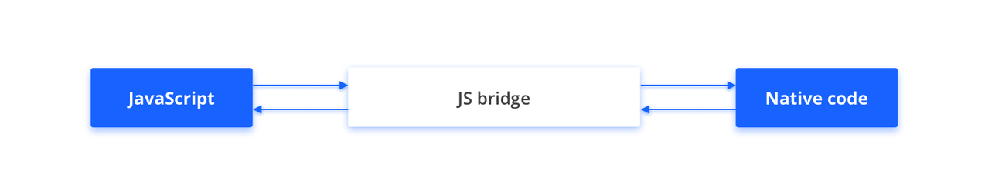
Frontend Integration JsAPI
Overview
The framework provides the developers with more JSAPI and OpenAPI capabilities so that they can launch diversified convenient services to the users.
For mini programs that are launched to different native apps, they run on different containers. The JSAPIs that these mini programs can call may vary. To resolve this problem, we recommend that mini program developers use JavaScript (JS) bridge for mini programs to call the standard JSAPIs provided by Mini Program Platform.
JS bridge works as a bridge that builds a two-way channel for communication between JavaScript and native code. By using JS bridge, mini program developers can call JSAPIs for the mini programs launched to different native apps.
Binding - my.getAuthCode
https://mini-program.dana.id/docs/miniprogram_dana/mpdev/api_openapi_getauthcode
Complete guidelines of the JSAPI:
https://mini-program.dana.id/docs/miniprogram_dana/mpdev/api_overview
Payment - my.tradePay
https://mini-program.dana.id/docs/miniprogram_dana/mpdev/api_openapi_tradepay

Slide 10
Backend Integration Guideline
Step | Action | PIC
1. Register and Obtain Credentials | Register on the Merchant Portal to retrieve your sandbox credentials, including the necessary Mini Program Console access. | Partner
2. Submit Credentials to DANA | Provide the DANA Integration Team with your clientID, merchantID, and MiniProgramID / AppID to initiate the backend setup. | Partner
3. Finalize Configuration | The DANA Team will complete the internal configuration using the provided details. | DANA
4. Begin Development | Start your development work. Use the sequence diagram as a technical reference: partner_onboarding | Partner
5. Get Support | Direct all technical questions to the DANA Team via the tech group. A quick call can be scheduled if immediate discussion is necessary. | DANA & Partner

Slide 11
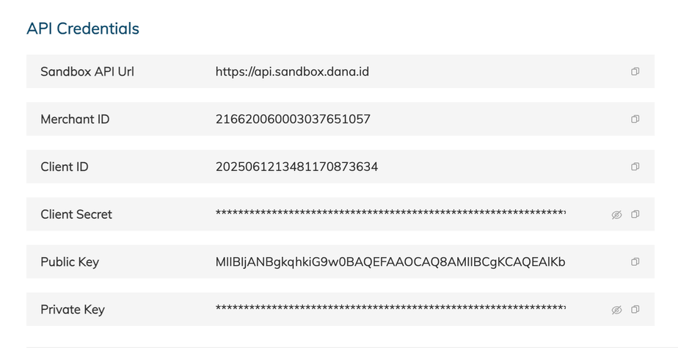
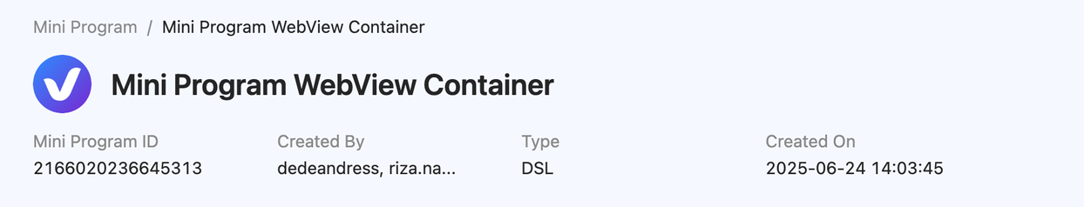
Backend Integration Guideline
Sample credentials from the Merchant portal
Sample appId information from Mini Program portal

Slide 12
Backend Integration API
Name | Reference URL
Partner Integration Document | https://danaindonesia.sharepoint.com/:b:/r/sites/Ventures/Shared%20Documents/MiniProgram/ONBOARDING%20TEMPLATES/Backend%20Onboarding%20Docs/Partner_Webview_Onboarding.pdf?csf=1&web=1&e=BdPTBy
DANA API Documentation | Signature Creation : https://dashboard.dana.id/api-docs-v2/guide/authentication API Apply Token : https://dashboard.dana.id/api-docs/read/111 API Query User Profile : https://dashboard.dana.id/api-docs/read/38 API Direct Debit / Cashier : https://dashboard.dana.id/api-docs/read/122 API Payment Notify : https://dashboard.dana.id/api-docs/read/123
Postman Collection for Mini Program Integration | https://danaindonesia.sharepoint.com/:u:/r/sites/Ventures/Shared%20Documents/MiniProgram/ONBOARDING%20TEMPLATES/Backend%20Onboarding%20Docs/Mini%20Program%20DANA%20Postman%20Collection.zip?csf=1&web=1&e=348AvX

Slide 13
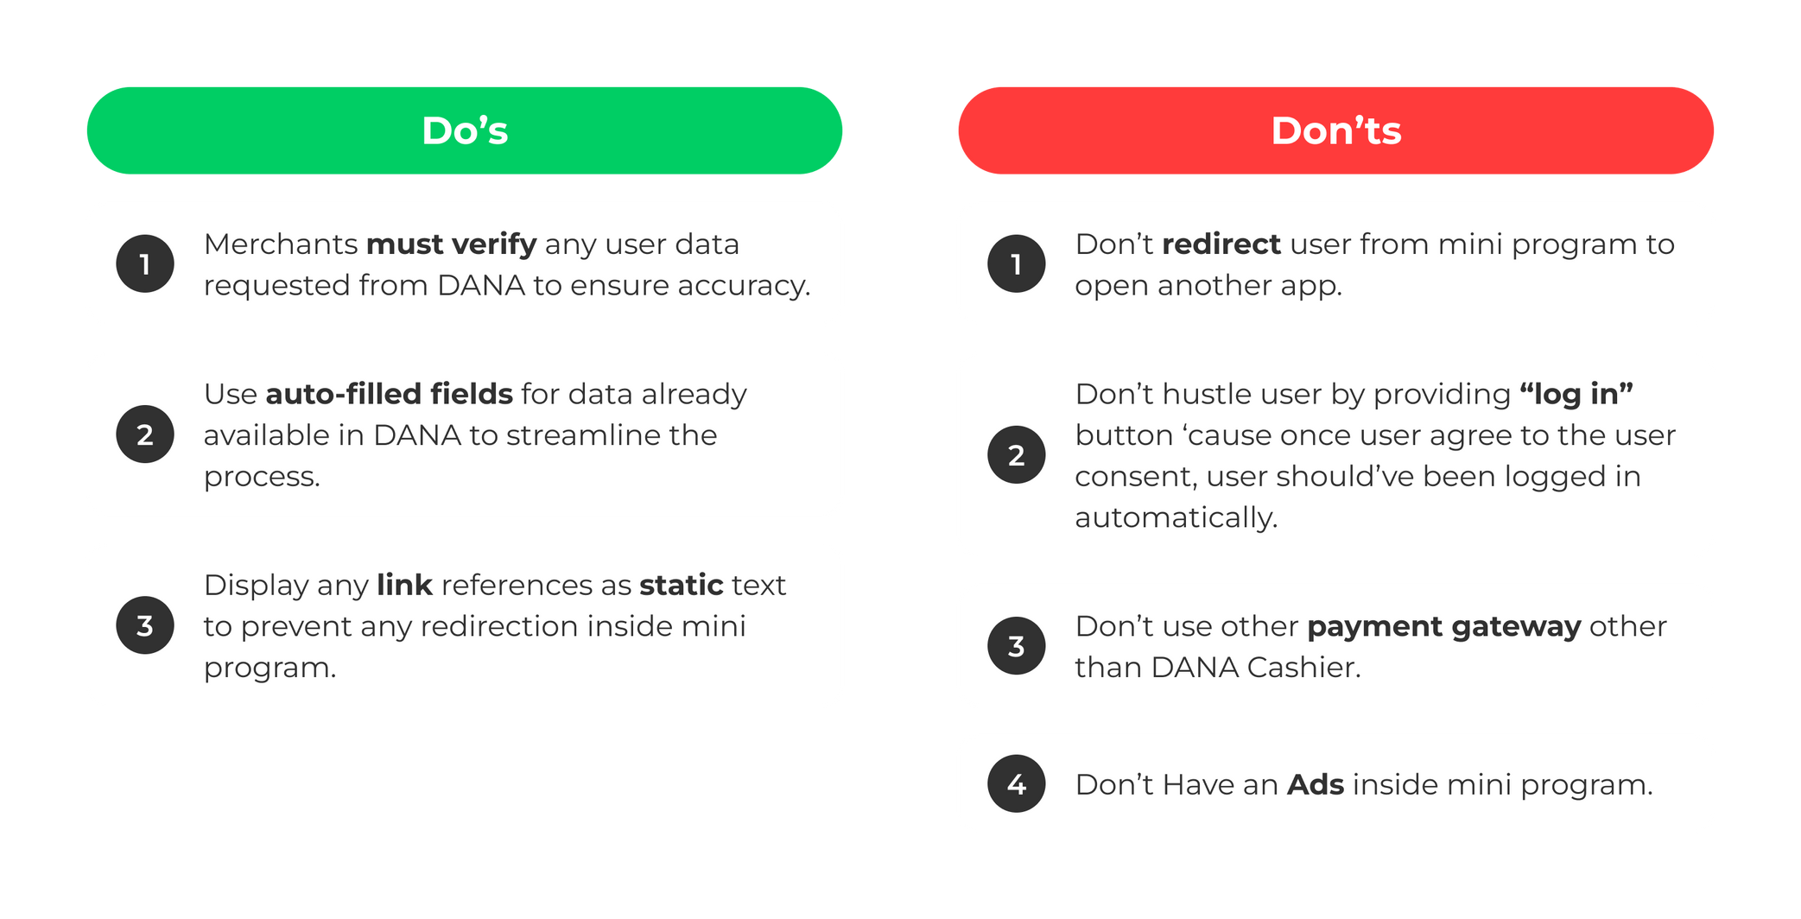
UI Guideline
Do’s & Don'ts In Mini Program
Please follow bellow do’s & don’ts in DANA Mini Program

Slide 14
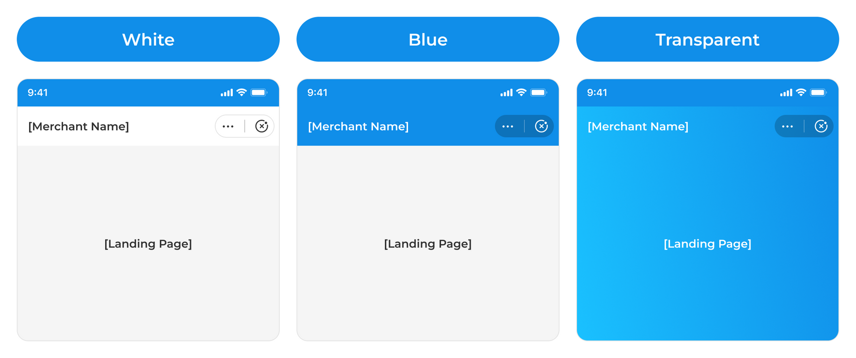
UI Guideline
Navigation Bar Variants
The navigation bar color depends on partner’s brand or is transparent.

Slide 15
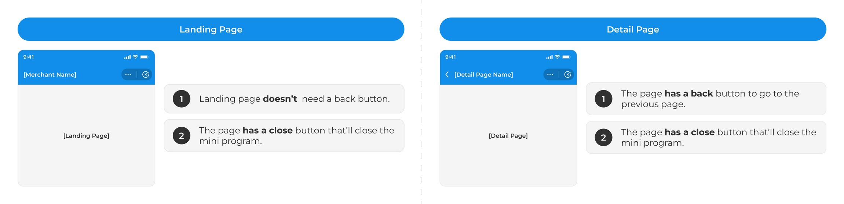
UI Guideline
Navigation Spesification
All Mini Programs must have a default navigation bar

Slide 16
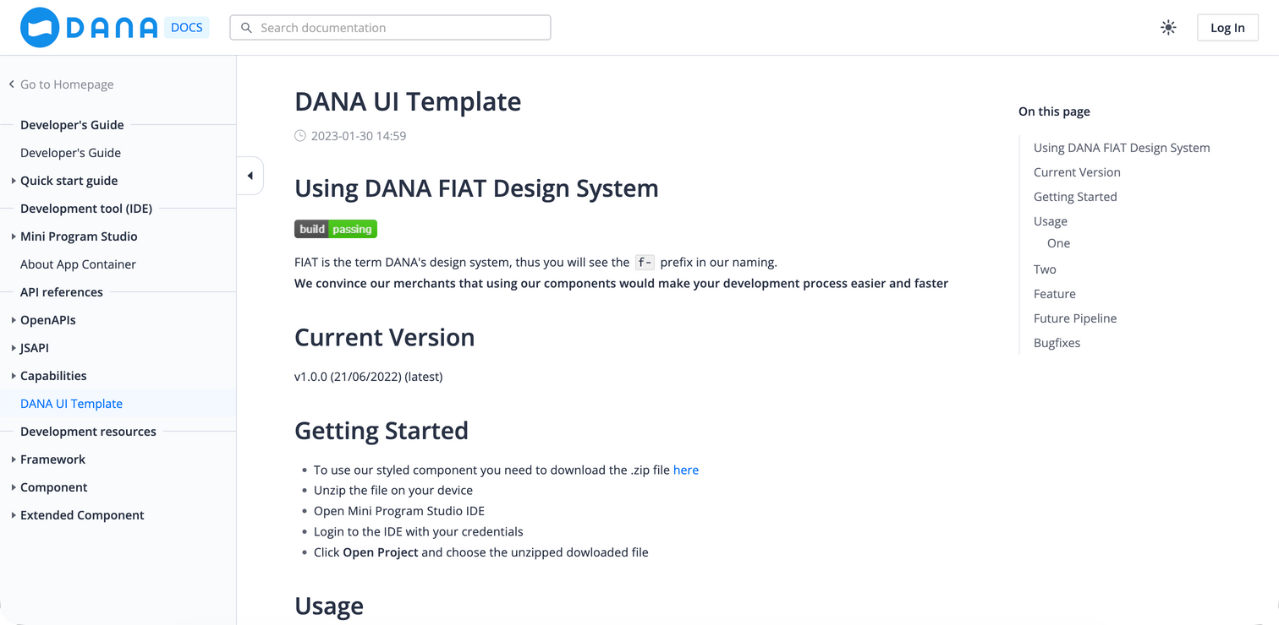
UI Guideline
Library UI Mini Program DANA
We provide a design system with reusable components to help partners create UIs more efficiently.
Library DANA Mini Program

Slide 17
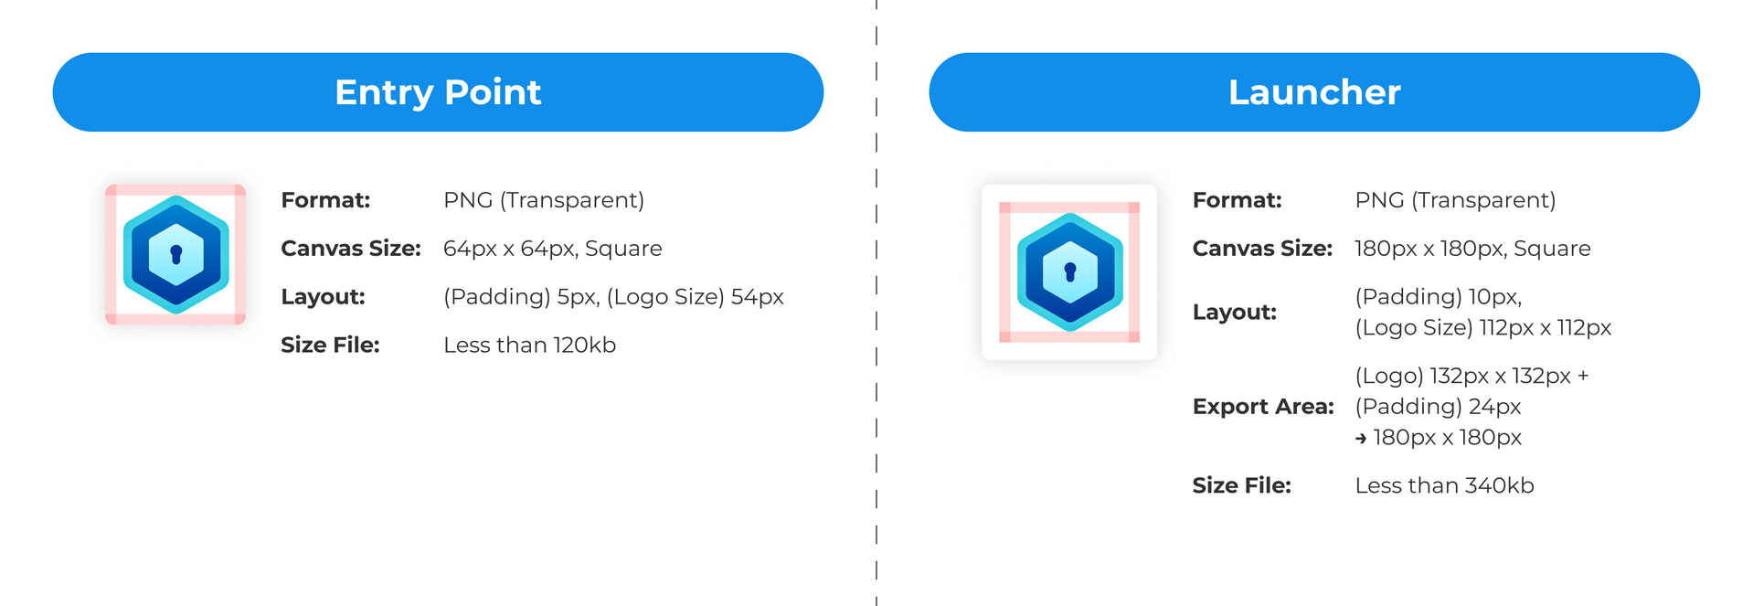
Design Handoff
Brand Logo for Entry Point & Launcher
Logo will be placed on the All Services page. Ensure it matches the logo when you onboard DANA.
Please provide logos for the Entry Point and Launcher as per the guidelines below. For All Services entry point, use a logo icon for better visibility in small sizes.

Slide 18
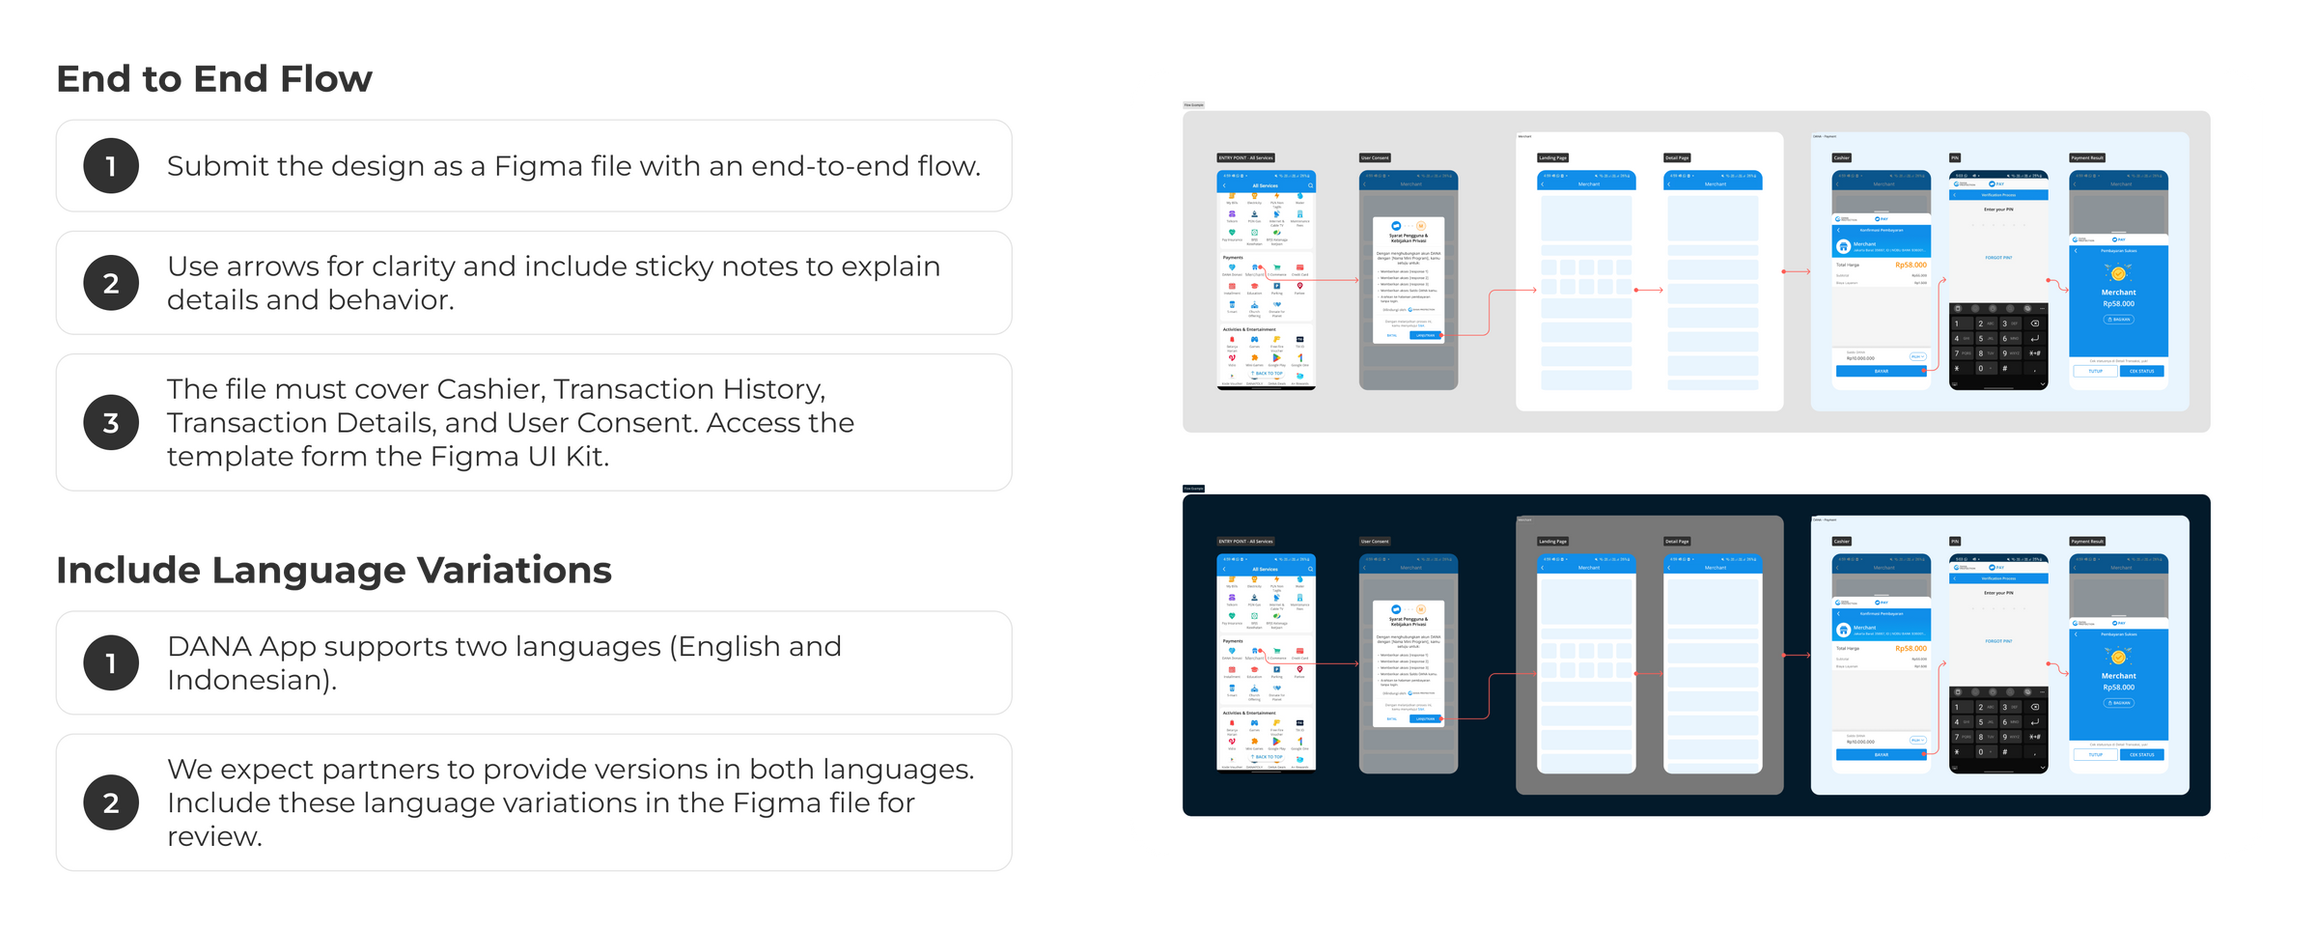
Design Handoff

Slide 19
Thank you

